Slide 1

Vision Zero: A NYC Policy Analysis
Syeda Nahar

Slide 2

Introduction
Research Question
Data
Analysis
Summary

Slide 3

INTRODUCTION
As a driver in NYC, I have directly experienced the changes in our city laws and regulations pertaining to traffic safety. Most if not all the changes in NYC traffic rules can be traced back to Vison Zero. So, what exactly is it? Vison Zero is a strategy adopted by NYC in 2014 to keep the streets of the city safe by reducing and ideally eliminating traffic related accidents, injuries, and deaths.

Slide 4

PRIMARY GOAL AND IMPLEMENTATION
Vision Zero

Slide 5
“The primary mission of government is to protect the public.” https://www.nyc.gov/content/visionzero/pages/
This strategy can be traced back to it’s first implementation in Sweden in the 90’s where
it was hugely useful and later adopted by many European cities. The Vision Zero strategy targets
changes within the city designs and policies instead to prevent unforeseeable accidents, whereas
the traditional approach just accepted these issues as inevitable.
The first and most prominent changes to NYC Traffic Laws after adopting Vision Zero was
lowering the default citywide speed limit from 30mph to 25mph in 2014. Then in 2019, the city
expanded its network of school zone speeding cameras from 150 zones to 750 zones with
limited times of operation. In 2022, the most recent change came after the Governor removed
the restrictions of these camera’s operating time and made then 24/7. Some other changes
include mandatory rear seat belt use, strengthening penalties for traffic violations, adding
pedestrian islands and protected bike lanes.

Slide 6
Research Question
Effect of the Vision Zero Strategy implementation in NYC:
• Did motor vehicle collisions increase or decrease after introducing stricter legislation/penalties between 2014-2017?
• Did the expansion of speeding cameras in 2019 and new street designs affect vehicle collisions in the city?
• Have the contributing factors in vehicle collisions changed over the years?
• How have protected bike lanes impacted bicyclist injuries and bicyclist fatalities? (Comparison between 2019-2021 Data)

Slide 7
Data Source Information
OpenData Motor Vehicle Collisions – Crashes: contain information from all police reported motor vehicle collisions in NYC. This report (MV 104-AN) is required to be filled out for collisions where someone is injured or killed, or where there is at least $1000 worth of damages. It should be noted that the data is preliminary and subject to change when the MV-104AN forms are amended based on revised crash details.
OpenData Open Parking and Camera Violations: contains a list of all the parking and camera violations. New or open violations will be updated weekly (Sunday).Violations satisfied by having been paid, dismissed via hearing, statutorily expired, or had other changes to its status, will be updated daily (Tuesday through Sunday). Violations that have been written-off because they have statutorily expired and are no longer valid are indicated with blank financials. Summons images will not be available during scheduled downtime on Sundays from 5:00 am to 10:00 am.
NYC Department of Transportation Bicycle Crash Data: contains the total number of bicycle crashes reported by city agencies, information on crashes involving only bicycles, between bicycles and motorized vehicles, and between bicycles and pedestrians. This data includes the number of injuries resulting from such crashes and is grouped by borough and by police precinct.

Slide 8

Data Analysis

Slide 9
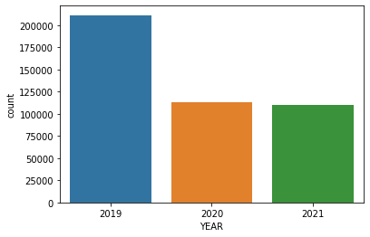
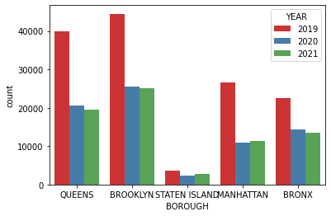
Motor Vehicle Crash Reported Over 3 Years
Crashes Reported from 2019-2021
Crashes Reported from 2019-2021
(By Boroughs)

Slide 10
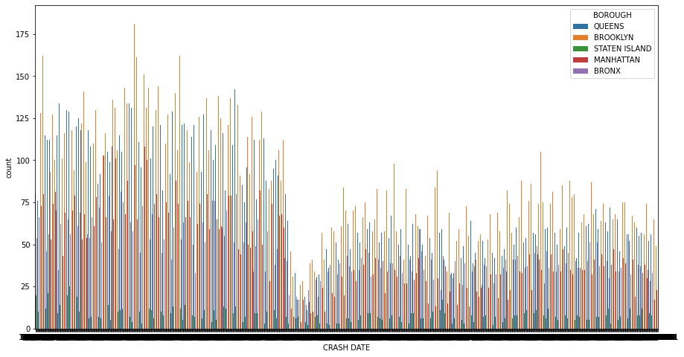
Time Series Analysis

Slide 11
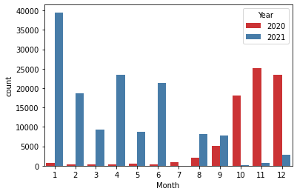
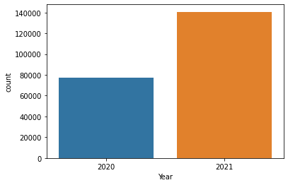
School Zone Speed Camera Tickets
Tickets by Month and Year
Tickets by Year

Slide 12
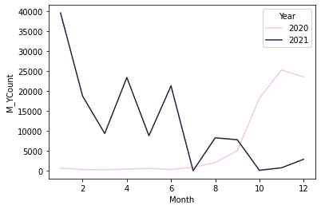
Count Over Month by Year

Slide 13
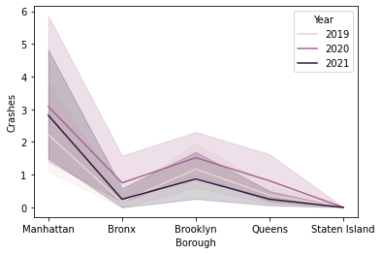
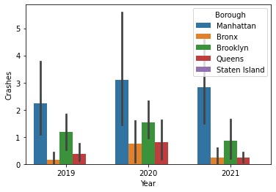
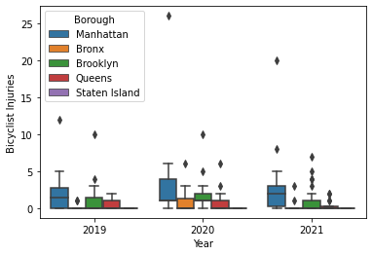
Reported Crashes Between Bicycles
By Borough
Over the Years
Injuries Reported

Slide 14
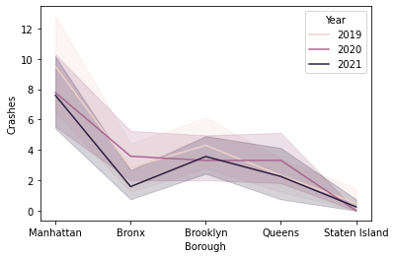
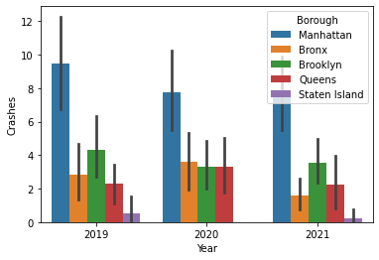
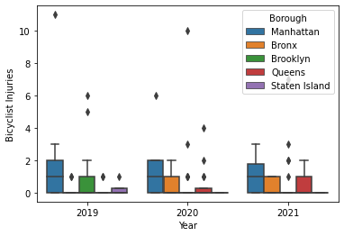
Reported Crashes Between Bicycles and Pedestrians
By Borough
Over the Years
Injuries Reported

Slide 15
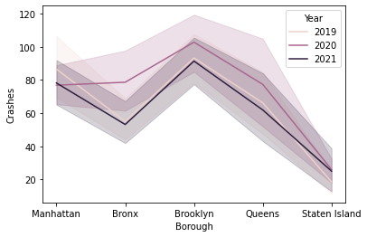
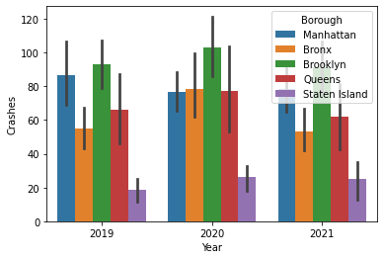
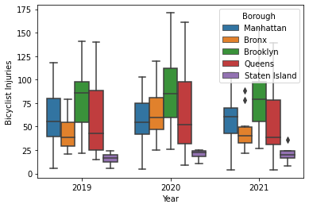
Reported Crashes Between Bicycles and Motor Vehicles
By Borough
Over the Years
Injuries Reported

